Slide 1


Welcome you all
DCL
Day - 5
D.Sakthivel
Assistant Professor & Trainer,
KGiSL Micro College
KGiSL Campus, Coimbatore – 641 035.

Slide 2
Day 5
What is DCL?
Create Users
Show Users
Set and Update Password
Grant Privilege
Revoke Privilege
Demonstration

Slide 3
MySQL | CREATE USER Statement
MySQL allows us to specify which user account can connect to a database server. The user account details in MySQL contains two information – username and host from which the user is trying to connect in the format username@host-name.
If the admin user is connecting through localhost then the user account will be admin@localhost.
MySQL stores the user account in the user grant table of the mysql database.
Syntax: The syntax for the CREATE USER statement in MySQL is:
CREATE USER user_account IDENTIFIED BY password;

Slide 4
MySQL |DCL
Data control language (DCL) is used to access the stored data.
It is mainly used for revoke and to grant the user the required access to a database.

Slide 5
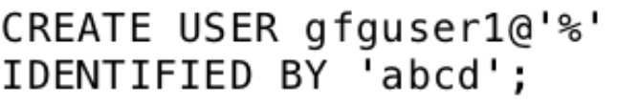
MySQL | CREATE USER Statement
Parameters used:
user_account: It is the name that the user wants to give to the database account.The user_account should be in the format ‘username’@’hostname’
password:It is the password used to assign to the user_account.The password is specified in the IDENTIFIED BY clause.
Allowing a user account to connect from any host: To allow a user account to connect from any host, the percentage (%) wildcard is used in the following way. Syntax:

Slide 6
MySQL | CREATE USER Statement
Viewing permissions of an User Account: The “Show Grants” statement is used to view the permissions of a user account.The show grants statement is used in the following way: Syntax: SHOW GRANTS FOR user-account;

Slide 7
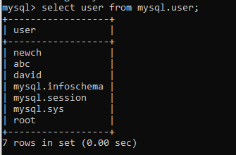
MySQL | SHOW ALL USERS:
SELECT user FROM mysql. user;
Select current_user ()

Slide 8
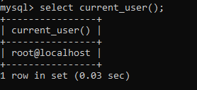
MySQL | SHOW Cuurent USERS:
Select current_user ()

Slide 9
MySQL | Change User Password
In MySQL, the user account password can be changed using 3 different statements:
UPDATE statement
SET PASSWORD statement
ALTER USER statement.
But before changing the password of an account, two very important things should be kept in mind:
The user account details for which you want to change the password.
The application is being used by the user whose password you are going to change because if the password is changed without changing the connection string of the application then the application will not be able to connect to the database server.

Slide 10
MySQL | Change User Password
1. Changing MySQL User Password Using The SET PASSWORD Statement:
To change the user password using the SET PASSWORD statement the first requirement is that the account needs to have at least UPDATE privilege.

Slide 11

MySQL | Change User Password
2. Changing MySQL User Password Using The ALTER USER statement:
The second way to change the password for a user account is to use the ALTER USER statement.
The ALTER USER statement is used along with the “IDENTIFIED BY” clause.

Slide 12
MySQL | Change User Password
3. Changing MySQL User Password Using UPDATE Statement:
The third way to change the password of a user account is by using the UPDATE statement.
The Update statement updates the user table of the mysql database.
The FLUSH PRIVILEGES statement needs to be executed after executing the UPDATE Statement.
The FLUSH PRIVILEGES statement is used to reload privileges from the grant table in the mysql database.

Slide 13
MySQL | Change User Password
2. Changing MySQL User Password Using The ALTER USER statement:
The second way to change the password for a user account is to use the ALTER USER statement.
The ALTER USER statement is used along with the “IDENTIFIED BY” clause.

Slide 14
Granting Privileges
The Create User Statement only creates a new user but does not grant any privileges to the user account.
Therefore to grant privileges to a user account, the GRANT statement is used.
Syntax:
GRANT privileges_names ON object TO user;

Slide 15
Parameters Used:
privileges_name: These are the access rights or privileges granted to the user.
object:It is the name of the database object to which permissions are being granted. In the case of granting privileges on a table, this would be the table name.
user:It is the name of the user to whom the privileges would be granted.

Slide 16
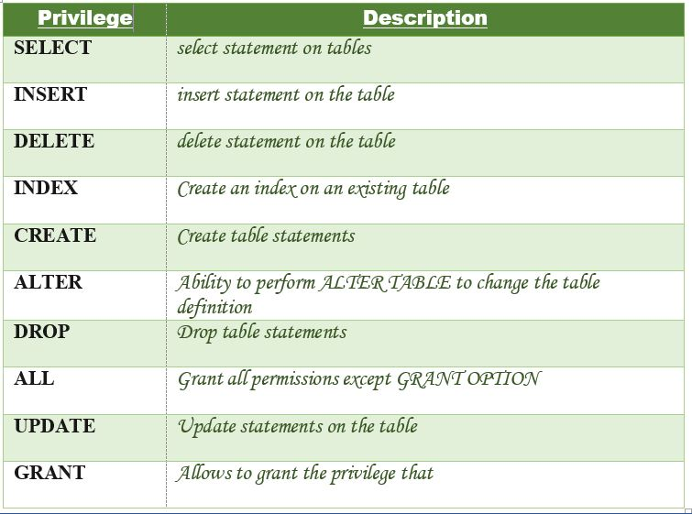
Parameters Used:
Privileges: The privileges that can be granted to the users are listed below along with

Slide 17
Parameters Used:
Privileges: The privileges that can be granted to the users are listed below along with
Granting SELECT Privilege to a User in a Table:
To grant Select Privilege to a table named “users” where User Name is david, the following GRANT statement should be executed.

Slide 18
Parameters Used:
Granting more than one Privilege to a User in a Table:
To grant multiple Privileges to a user named “david” in a table “users”, the following GRANT statement should be executed.

Slide 19
Parameters Used:
Granting All the Privilege to a User in a Table:
To Grant all the privileges to a user named “david” in a table “users”, the following Grant statement should be executed.

Slide 20
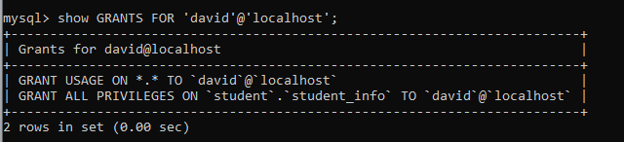
Checking the Privileges Granted to a User:
To see the privileges granted to a user in a table, the SHOW GRANTS statement is used.
To check the privileges granted to a user named “david” and host as “localhost”, the following SHOW GRANTS statement will be executed:
SHOW GRANTS FOR ‘david'@localhost';

Slide 21
Revoking Privileges from a Table
The Revoke statement is used to revoke some or all of the privileges which have been granted to a user in the past.
Syntax:
REVOKE privileges ON object FROM user;
Parameters Used:
object: It is the name of the database object from which permissions are being revoked. In the case of revoking privileges from a table, this would be the table name.
user: It is the name of the user from whom the privileges are being revoked.

Slide 22
Revoking SELECT Privilege to a User in a Table:
To revoke Select Privilege to a table named “users” where User Name is david, the following revoke statement should be executed.
REVOKE SELECT ON users FROM ‘david'@localhost';
Revoking more than Privilege to a User in a Table:
To revoke multiple Privileges to a user named “david” in a table “users”, the following revoke statement should be executed.
REVOKE SELECT, INSERT, DELETE, UPDATE ON Users FROM ‘david'@'localhost;

Slide 23
Revoking All the Privilege to a User in a Table:
To revoke all the privileges to a user named “david” in a table “users”, the following revoke statement should be executed.
REVOKE ALL ON Users FROM ‘david'@'localhost;

Slide 24
MySQL Login with Different User Account
The user account in MySQL contains essential information for the MySQL accounts, such as login information, account privileges, and the host information.
Therefore, to access and manage the databases in MySQL, we need to create a user account.
We can create several user accounts on the MySQL server and used them whenever we need them.
Syntax
mysql -u username -p
After pressing the enter key, we need to write the same password associated with the user:
Enter password: **********

Slide 25
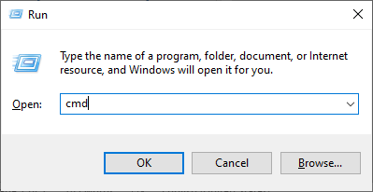
If we want to login to a different user account, we need to open the command prompt by executing the RUN command in the search box or pressing the Windows + R shortcut key.
It will display the screen where we type CMD and click the OK button.
Now, we will follow the steps given below to reach the location of the bin directory:
Step 1: Suppose we have installed MySQL in the C folder on our device. Then, copy that folder and paste it into our command prompt and press the Enter key.

Slide 26
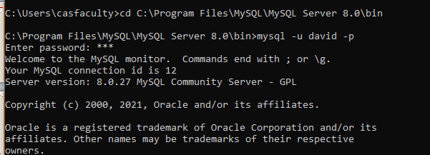

Slide 27
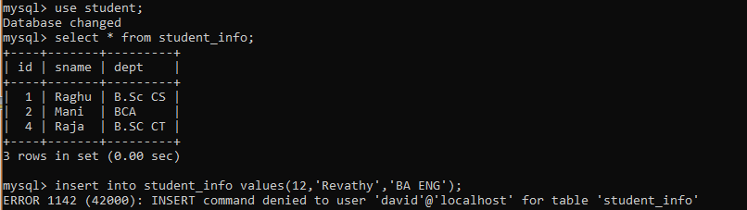

Slide 28



Thank You

